Slide 1

Lecture 11: Peer Evaluation
Dr. Tsung-Wei Huang
Department of Electrical and Computer Engineering
University of Utah, Salt Lake City, UT
Notes:
Hello everyone, today we are going to help you go through the team forming process.

Slide 2

What is a Peer-evaluation?
Not to criticize your project but help refine it

Slide 3
Why Should I Care?
Listen to what potential customers really want
Project execution is different from product profiting
Project success is different from product success
In Lab, you claim success if one out of 100 is viable
In market, you claim success if 99% yield is viable
But, how do I know?
The simplest way is to talk to potential customers
Will you buy it?
What kind of features you need before you buy it?
How much price you think is reasonable?
You won’t be able to do this by talking to others

Slide 4
Evaluate Your Peer’s Projects
We have opened 10 breakout rooms
Zoom: https://utah.zoom.us/j/2468214418
1-9 are assigned for teams from last week
Thesis track students are in room 10
Working sheet: https://docs.google.com/spreadsheets/d/1JfWZkEyoXdVLtHkiwOqk24G7WVhLWMCP113cSe9fgsQ/edit#gid=547552200
Each group work together to do the following:
Review all other project websites (including thesis track)
Comment on each of the other projects
What is the practical use of this project?
What are the challenges to implement this project?
What is the marketplace for this project?
Will we buy it?
What to improve the project from an outsider’s perspective
Post your comment as a reply to that project’s GitHub post

Slide 5
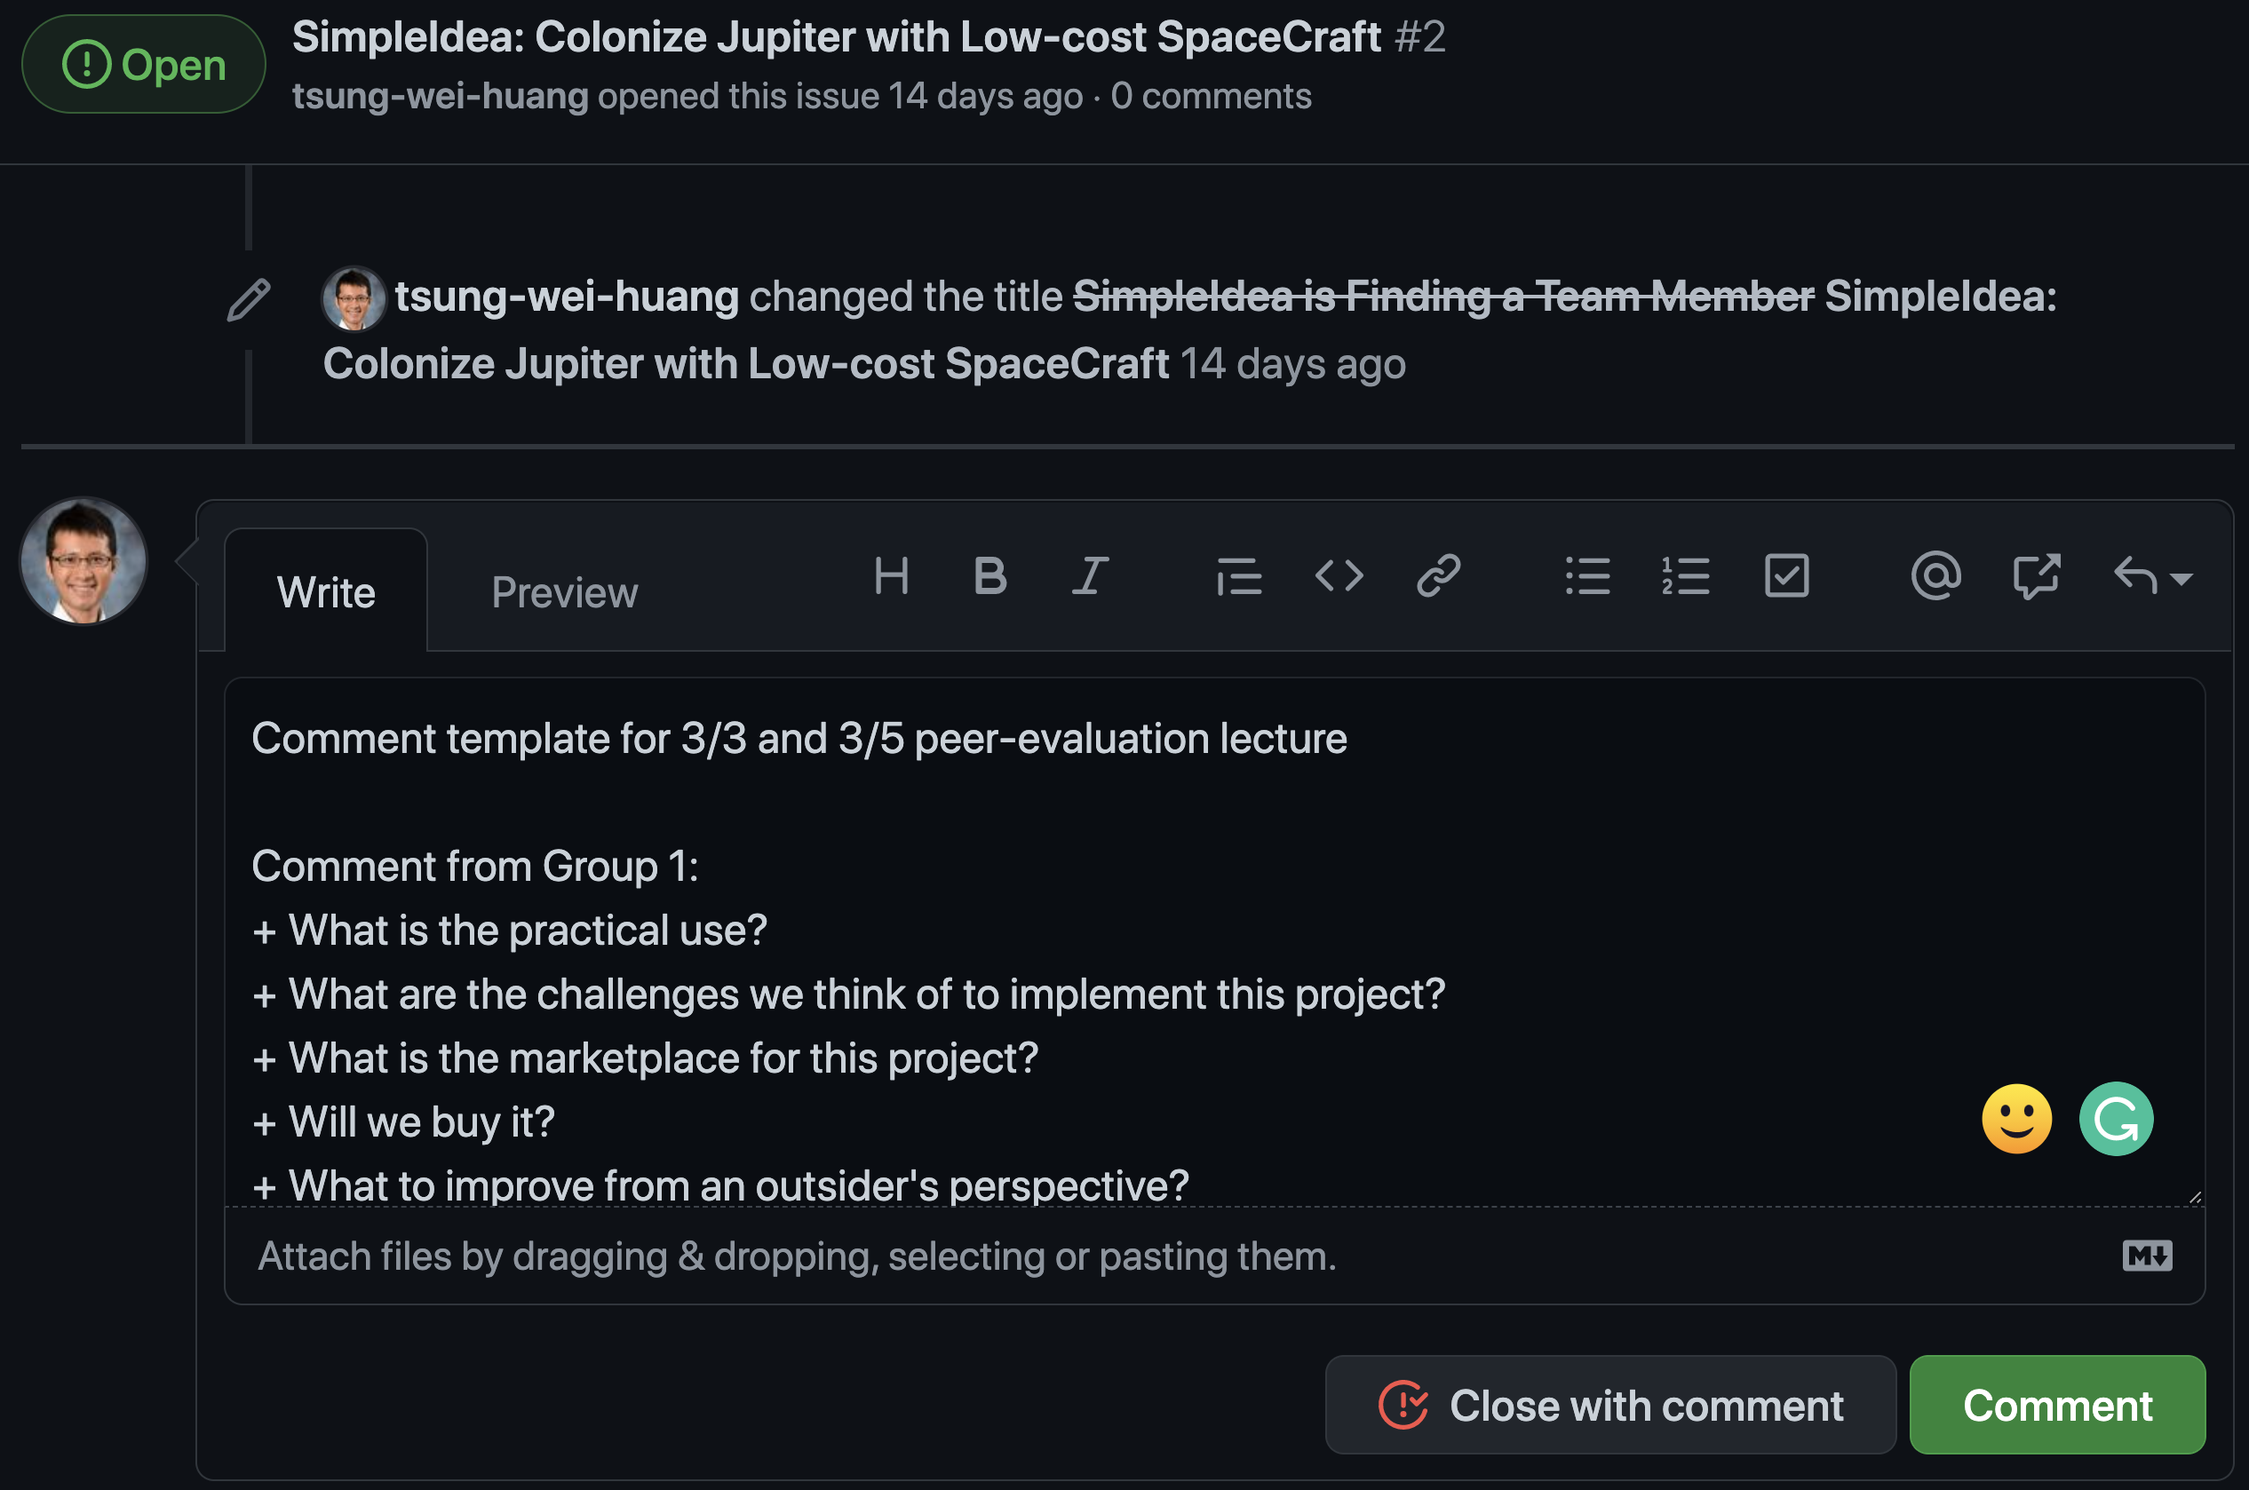
To Get You Off the Ground
Each team spends 5 mins to update your issue page
https://github.com/tsung-wei-huang/cs3992/issues
Include your website in good place others can see
Each team spends the rest to review other projects
Write your comment as a reply to the issue post
Each group needs to review all the other projects (incl. thesis track), except your own projects!!! You can run your review/comments by reading their project website.

